Slide 1
DDS and Laser Locking
Meir Alon
Complex Physics

Slide 2
Outline
PLL-Phase Locked Loop
Fundamentals.
Phase Noise.
PLL Lab Examples.
DDS –Direct Digital Synthesizer
Fundamentals
Phase Trancation error
DDS Lab examples
Conclusions

Slide 3
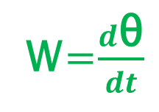
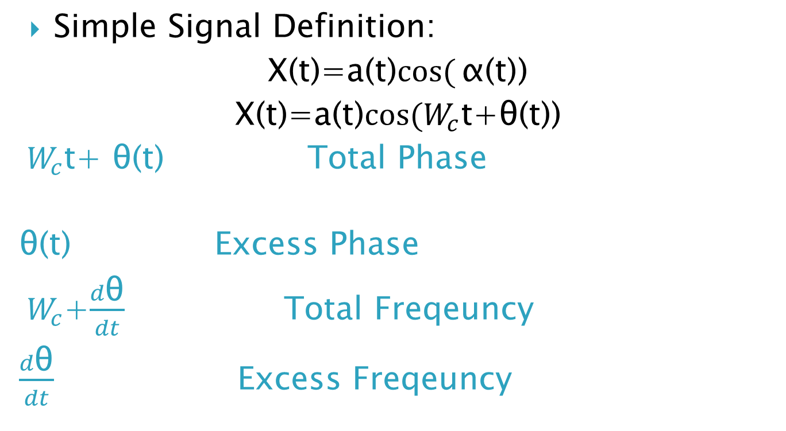

SIGNALS - DEFINITIONS
Simple Signal Definition:
X(t)=a(t)$cos({\text{α}\text{(}\text{t}\text{)}}$)
X(t)=a(t)$\cos{{(W}_{c}}$t+θ(t))
${ W}_{c}$t+ θ(t) Total Phase
θ(t) Excess Phase
${ W}_{c}$+$\frac{d\text{θ}}{dt}$ Total Freqeuncy
$\frac{d\text{θ}}{dt}$ Excess Freqeuncy
$$\text{θ}$$
3π
2π
π
t
W=$\frac{d\text{θ}}{dt}$
Phase
Frequency

Slide 4
PLL-BLOCK DIAGRAM

Slide 5
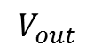
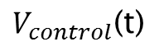
PLL Phase Locked Loop
Basic blocks of a PLL :
REF
Generates a voltage compared to the phase Different
Phase
Detector
Vout
VCO
Generates an RF frequency propotional to a voltage
$$V_{control}\text{(}\text{t}\text{)}$$
vco
$$V_{out}$$
Decay unwanted signals
And maintane stability.
Vin
Vout
Low Pass Filter

Slide 6
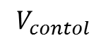
Loop with LPF
In this diagram we see a LPF is insereted
1)To reduce un wanted frequencys
2) To make better PLL Response.
REF
$$V_{contol}$$
Phase
Detector
VCO
Low Pass Filter
N
vco
Vout

Slide 7
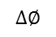
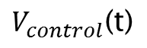
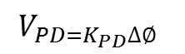

Phase Detector
So the Phase Detector compare the Phase between the signals
REF
Vout
$$V_{PD=K_{PD}∆∅ }$$
Phase
Detector
VCO
$$∆∅$$
$$V_{control}\text{(}\text{t}\text{)}$$
And we can say :$V_{PD=K_{PD}∆∅ }$

Slide 8
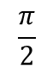
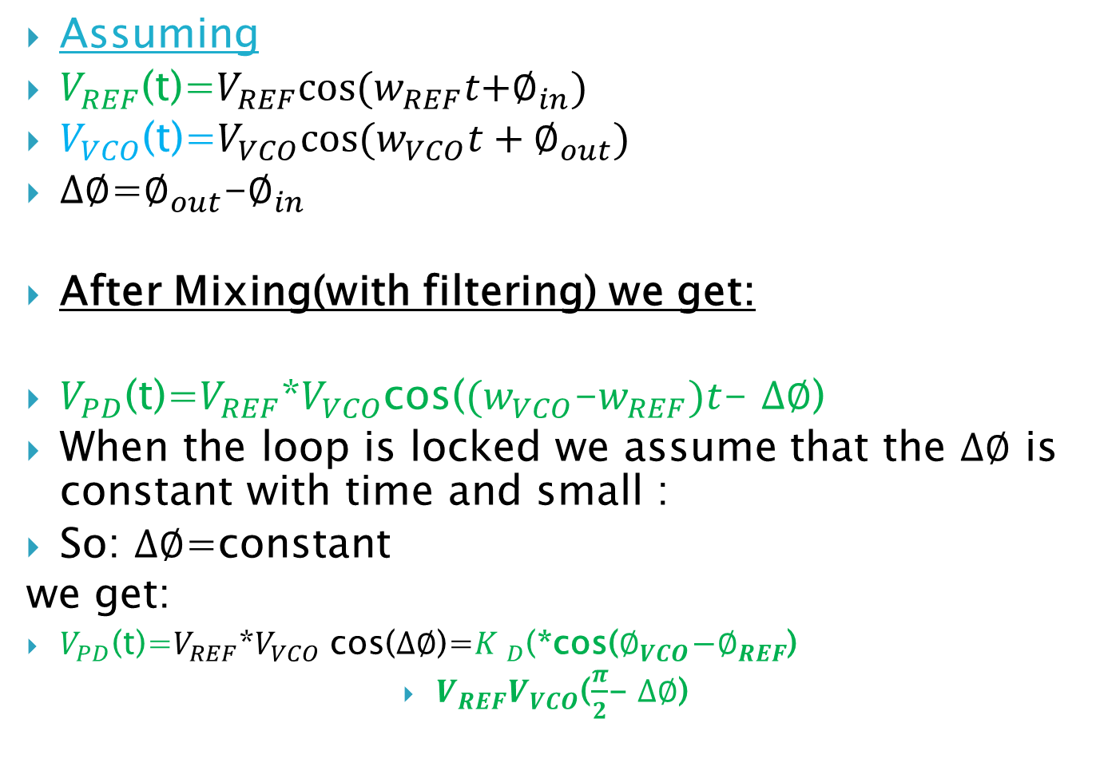
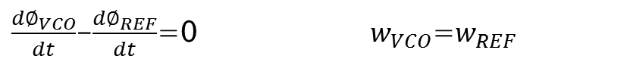
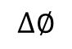
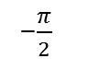
PLL-ANALYSIES:Phase Detector
Assuming
$V_{REF}$(t)=$V_{REF}cos(w_{REF}t{+∅}_{in})$
$V_{VCO}$(t)=$V_{VCO}cos(w_{VCO}t+∅_{out})$
$∆∅$=$∅_{out}$-$∅_{in}$
After Mixing(with filtering) we get:
$V_{PD}$(t)=$V_{REF}$*$V_{VCO}$cos(${(w}_{VCO}$-$w_{REF})t$- $∆∅$)
When the loop is locked we assume that the $∆∅$ is constant with time and small :
So: $∆∅$=constant
we get:
$V_{PD}$(t)=$V_{REF}$*$V_{VCO}$ cos($∆∅$)=${K }_{D}$(*cos($∅_{VCO}\text{−}∅_{REF}$)
$V_{REF}V_{VCO}$($\frac{π}{2}$- $∆∅$)
$\frac{d∅_{VCO}}{dt}$-$\frac{d∅_{REF}}{dt}$=0 $w_{VCO}$=$w_{REF}$
v
-$\frac{π}{2}$
$$\frac{π}{2}$$
$$∆∅$$

Slide 9
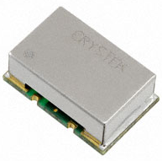
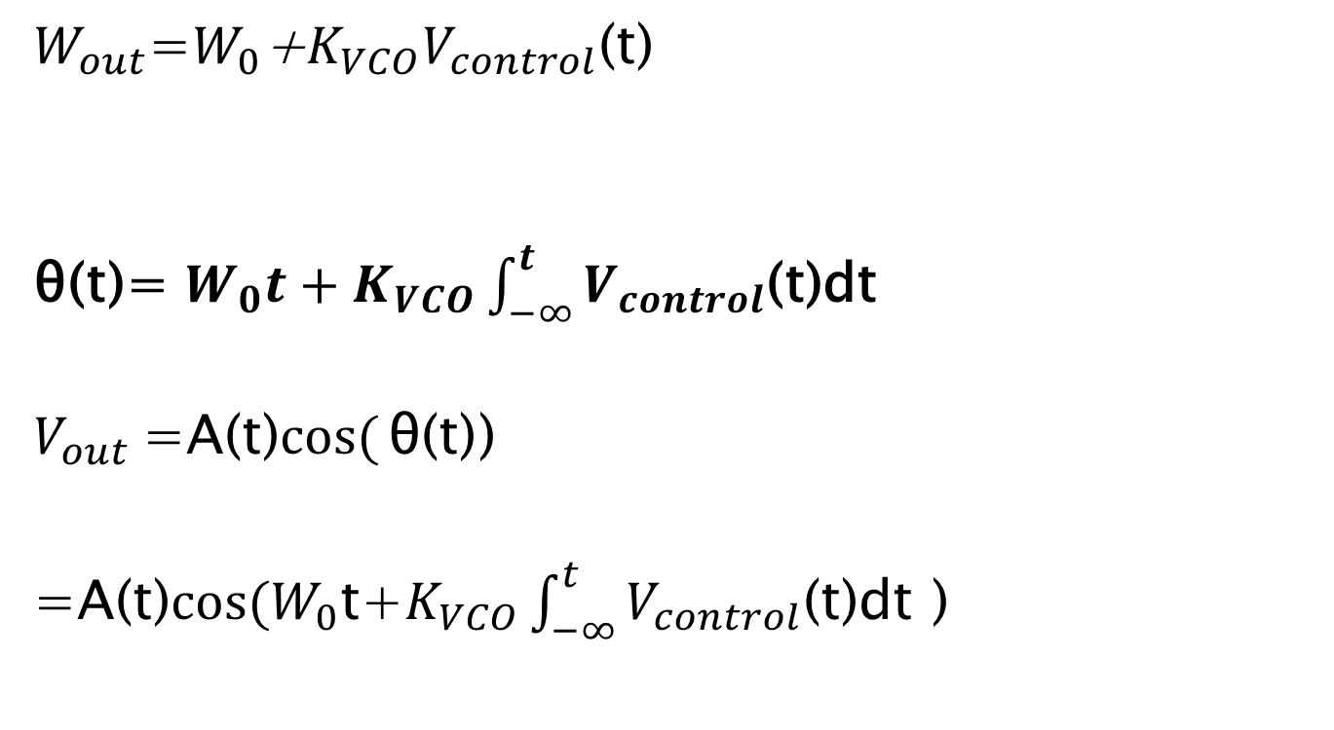
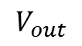
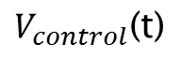
VCO:
$$V_{control}\text{(}\text{t}\text{)}$$
vco
$$V_{out}$$
$W_{out}$=$W_{0}$+$K_{VCO}V_{control}\text{(}\text{t}\text{)}$
$\text{θ}$(t)= $W_{0}t+K_{VCO}\int_{−∞}^{t}{V_{control}\text{(}\text{t}\text{)}\text{dt} }$
$V_{out}$=A(t)$cos({\text{θ}\text{(}\text{t}\text{)}}$)
=A(t)$\cos{{(W}_{0}}$t+$K_{VCO}\int_{−∞}^{t}{V_{control}\text{(}\text{t}\text{)}\text{dt} \text{)}}$
Wout
w1
w0
V1

Slide 10
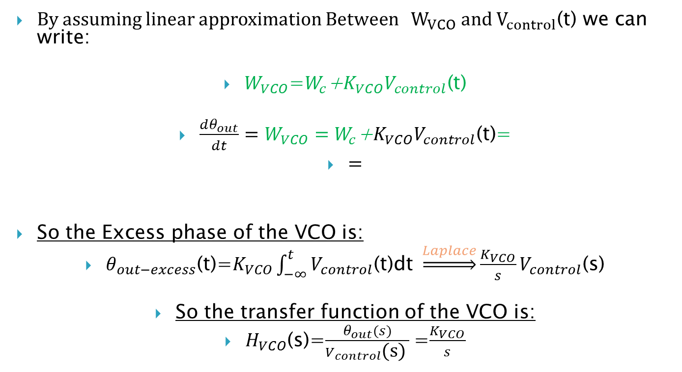
VCO Dynamics
By assuming linear approximation Between ${ W}_{VCO} and$ $V_{control}\text{(}\text{t}\text{)}$ we can write:
$W_{VCO}$=$W_{c}$+$K_{VCO}V_{control}\text{(}\text{t}\text{)}$
$\frac{dθ_{out}}{dt}=W_{VCO}=W_{c}\text{+}K_{VCO}V_{control}\text{(}\text{t}\text{)}$=
$=$
So the Excess phase of the VCO is:
$θ_{out−excess}$(t)=$K_{VCO}\int_{−∞}^{t}{V_{control}\text{(}\text{t}\text{)}\text{dt} }\underset{⇒}{Laplace}\frac{K_{VCO}}{s}V_{control}$(s)
So the transfer function of the VCO is:
$H_{VCO}$(s)=$\frac{θ_{out}(s)}{V_{control}\text{(}\text{s}\text{) }}$=$\frac{K_{VCO}}{s}$

Slide 11
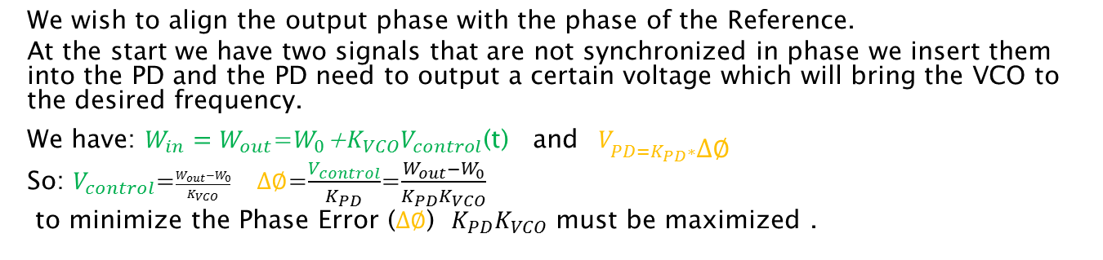
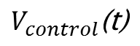
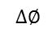
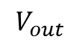
A PLL
Basic Block Diagram of Phase Locked Loop:
REF
$$V_{control}\text{(}\text{t}\text{)}$$
Vout
$$V_{out}$$
Phase
Detector
vco
VCO
$$∆∅$$
Wout
w1
w0
V1
We wish to align the output phase with the phase of the Reference.
At the start we have two signals that are not synchronized in phase we insert them into the PD and the PD need to output a certain voltage which will bring the VCO to the desired frequency.
We have: $W_{in}=W_{out}$=$W_{0}$+$K_{VCO}V_{control}\text{(}\text{t}\text{)}$ and $V_{PD=K_{PD}∗∆∅ }$
So: $V_{control}$=$\frac{{W_{out}−W}_{0}}{K_{VCO}} ∆∅$=$\frac{V_{control}}{K_{PD}}$=$\frac{W_{out}−W_{0}}{K_{PD}K_{VCO}}$
to minimize the Phase Error ($∆∅$) $K_{PD}K_{VCO}$ must be maximized .

Slide 12
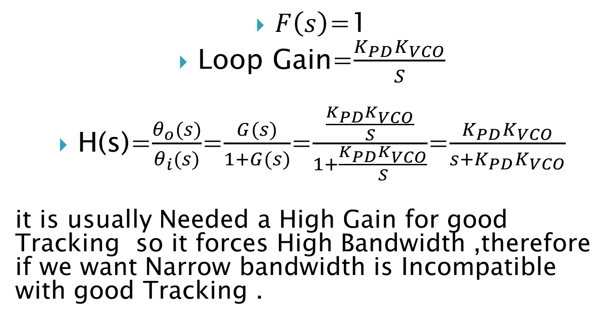
FIRST ORDER PLL
$F\left(s\right)$=1
Loop Gain=$\frac{{K_{PD}K}_{VCO}}{S}$
H(s)=$\frac{θ_{o}(s)}{θ_{i}(s)}$=$\frac{G(s)}{1+G(s)}$=$\frac{\frac{{K_{PD}K}_{VCO}}{S}}{1+\frac{{K_{PD}K}_{VCO}}{S}}$=$\frac{{K_{PD}K}_{VCO}}{s+{K_{PD}K}_{VCO}}$
it is usually Needed a High Gain for good Tracking so it forces High Bandwidth ,therefore if we want Narrow bandwidth is Incompatible with good Tracking .

Slide 13
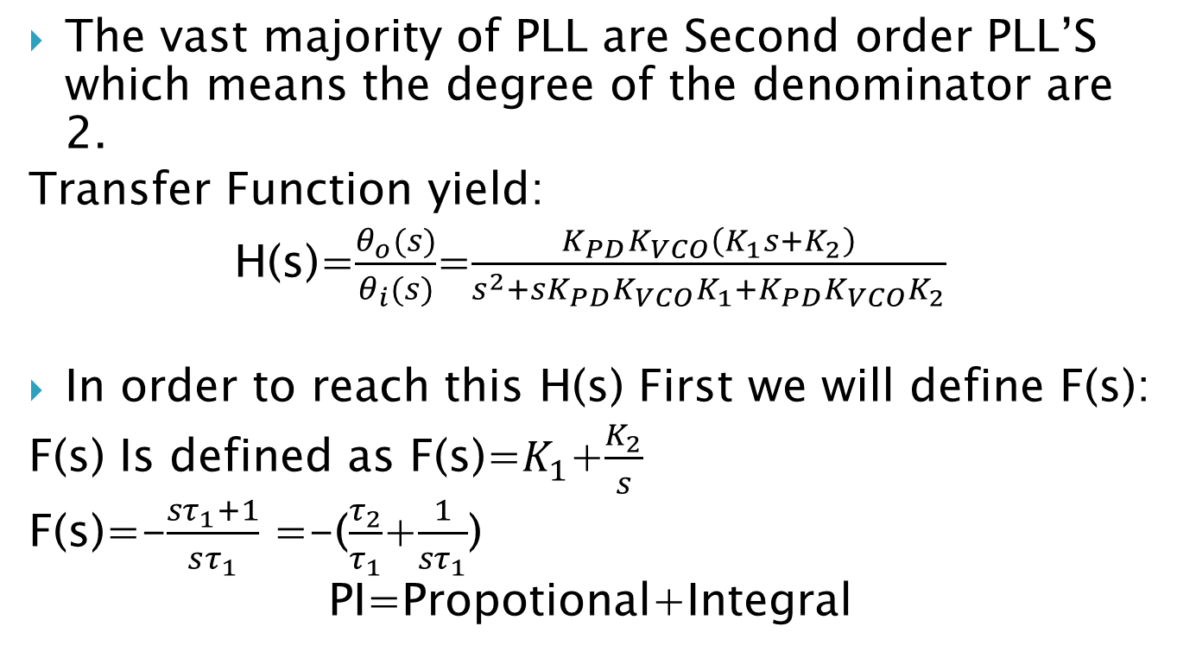
Second Order PLL
The vast majority of PLL are Second order PLL’S which means the degree of the denominator are 2.
Transfer Function yield:
H(s)=$\frac{θ_{o}(s)}{θ_{i}(s)}$=$\frac{{K_{PD}K}_{VCO}\left(K_{1}s+K_{2}\right)}{s^{2}+s{K_{PD}K}_{VCO}K_{1}+{K_{PD}K_{VCO}K}_{2}}$
In order to reach this H(s) First we will define F(s):
F(s) Is defined as F(s)=$K_{1}$+$\frac{K_{2}}{s}$
F(s)=-$\frac{{sτ}_{1}+1}{sτ_{1}}$ =-($\frac{τ_{2}}{τ_{1}}$+$\frac{1}{{sτ}_{1}}$)
PI=Propotional+Integral

Slide 14
SMALL TRANSIENTS

Slide 15
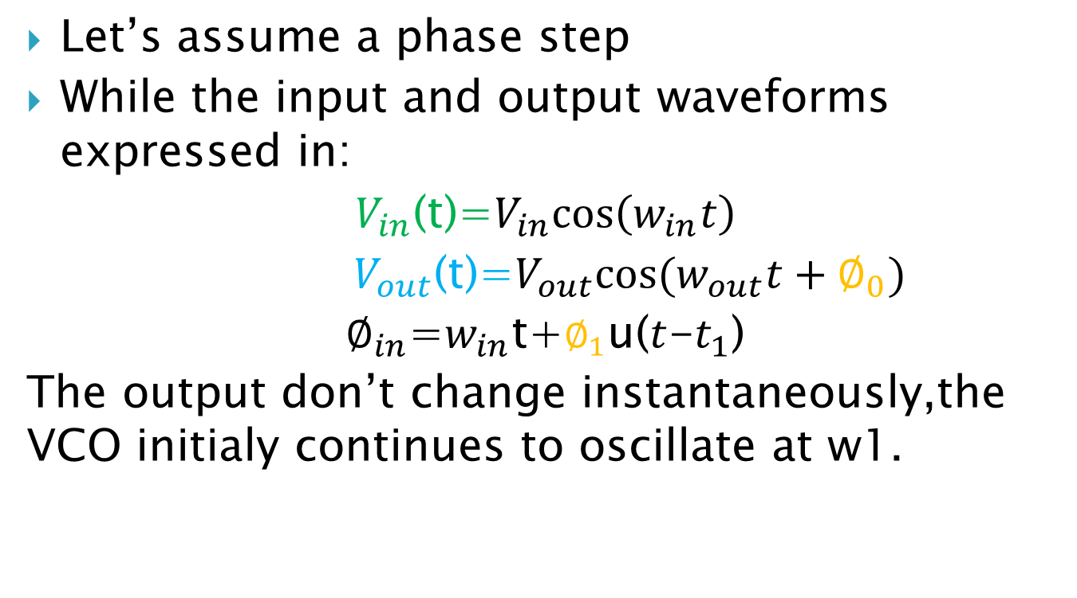
Locked Condition: Small transients in locked conditions
Let’s assume a phase step
While the input and output waveforms expressed in:
$V_{in}$(t)=$V_{in}cos\left(w_{in}t\right)$
$V_{out}$(t)=$V_{out}cos(w_{out}t+∅_{0})$
$∅_{in}$=$w_{in}$t+$∅_{1}$u($t$-$t_{1}$)
The output don’t change instantaneously,the VCO initialy continues to oscillate at w1.

Slide 16
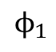
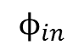
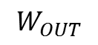
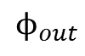
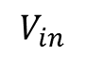
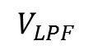
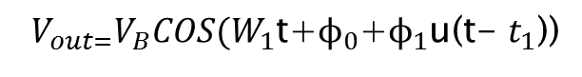
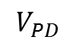
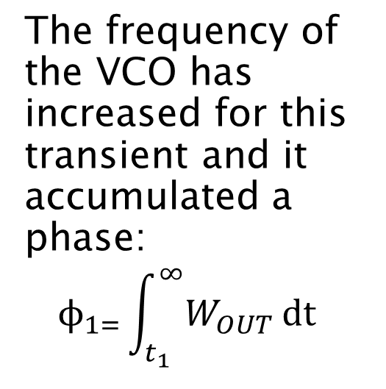
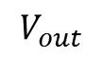
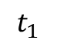
Let’s look at the waveform of this phase step:
The input phase grow cause phase difference between input and output, which creates pulses at the output of the Phase Detector.
$$V_{in}$$
The frequency of the VCO has increased for this transient and it accumulated a phase:
$$ϕ_{1=}\int_{t_{1}}^{∞}{W_{OUT}}dt$$
$$ϕ_{out}$$
$$ϕ_{in}$$
$$ϕ_{1}$$
$$V_{out}$$
$$V_{PD}$$
$$V_{LPF}$$
$$W_{OUT}$$
$$t_{1}$$
$V_{out=}V_{B}COS(W_{1}$t+$ϕ_{0}$+$ϕ_{1}$u(t- $t_{1}$))
And the output settles to

Slide 17
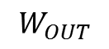
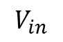
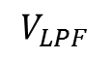
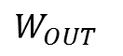

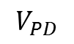
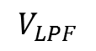
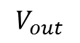
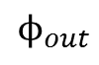
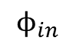
Let’s look at a Frequency jump: ∆W again at t=$t_{1}$
There is a frequency jump at the input,the VCO initially continues to oscillate at the same frequency. The PD generates wider pulses so rises with time.
$$V_{LPF}$$
As approces
Win+∆W the pulses width decreases.
Till the frequency reaches the same value.
$W_{OUT}$
$$V_{in}$$
$$ϕ_{in}$$
$$ϕ_{out}$$
$$V_{out}$$
$$V_{PD}$$
$$V_{LPF}$$
$$W_{OUT}$$

Slide 18
PLL Dynanics

Slide 19
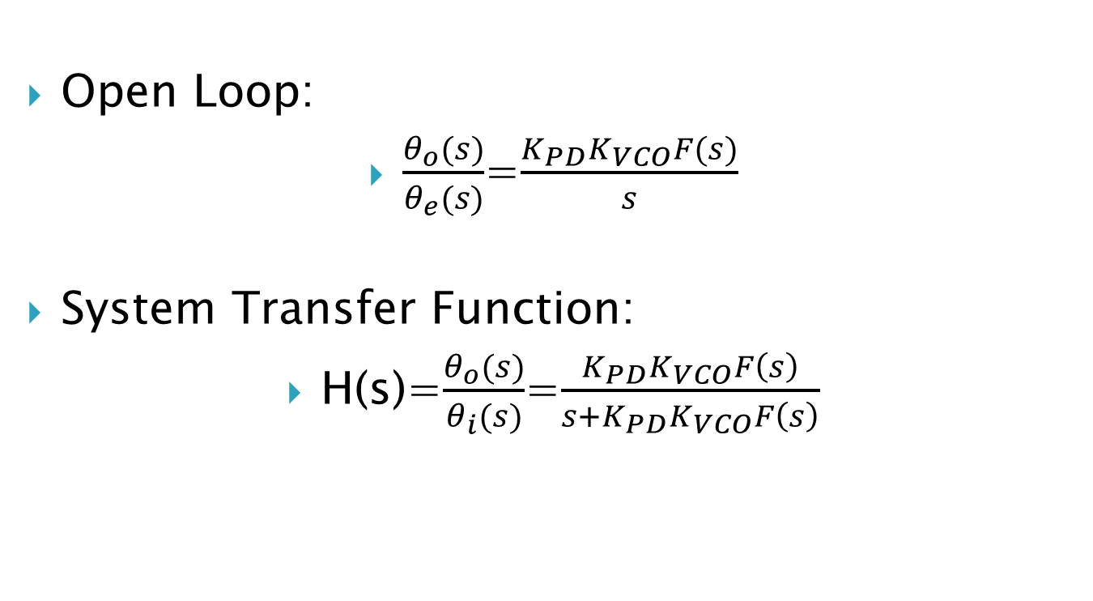
PLL-Transfer Function
Open Loop:
$\frac{θ_{o}(s)}{θ_{e}(s)}$=$\frac{{K_{PD}K}_{VCO}F(s)}{s}$
System Transfer Function:
H(s)=$\frac{θ_{o}(s)}{θ_{i}(s)}$=$\frac{{K_{PD}K}_{VCO}F\left(s\right)}{s+{K_{PD}K}_{VCO}F\left(s\right)}$

Slide 20
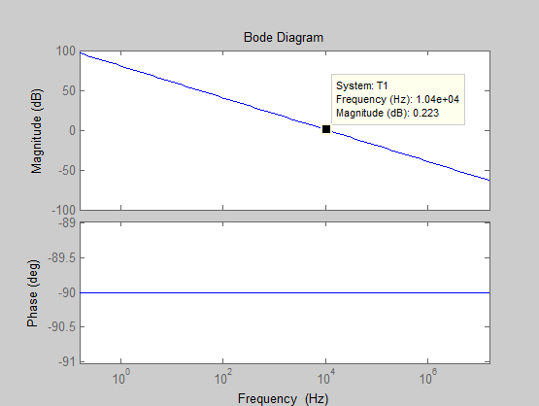
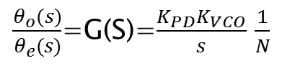
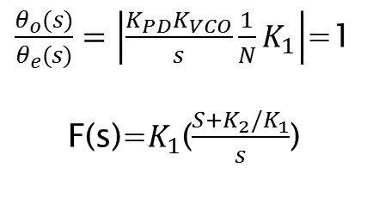
Bode Diagram of the Basic PLL
Loop Gain:
$\frac{θ_{o}(s)}{θ_{e}(s)}$=G(S)=$\frac{{K_{PD}K}_{VCO}}{s}$ $\frac{1}{N}$
We chose 10khz cross over frequency.
The loop gain magnitude should be 1 at the Cross Over Frequency (Fc):
$\frac{θ_{o}(s)}{θ_{e}(s)}=\left|\frac{{K_{PD}K}_{VCO}}{s}\frac{1}{N}K_{1}\right|$=1
F(s)=$K_{1}$($\frac{{S+K}_{2}/K_{1}}{s}$)

Slide 21
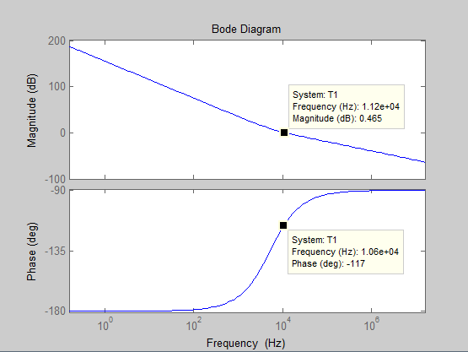
The Total system
You can see the cross over frequency at about 10khz and the phase margin of 63 degrees

Slide 22


Slide 23

PLL Designed in WIS
Specification:
1)Frequency : 1000 Ghz/ 6.8 Ghz
2)External / Internal Reference frequency.
Features:
1)Frequency Hoping by Profiles selection.
2)Frequency chirp sweep.
3)Parallel mode of opearation.
Specification:
1)Range 6.8-6.85 Ghz (Rubidium Range)
2) All DDS Features
2)External / Internal Reference frequency.
Features at High Frequency:
1)Frequency Hoping by Profiles selection.
2)Frequency chirp sweep.
3)Parallel mode of opearation.
DDS Scaling

Slide 24

PLL Designed in WIS
Specification:
1)Phase Detector Range :
Up to 300 Mhz
2)External / Internal Reference frequency.
Features:
1)PID mechanical settings.
2)Working with beats from lasers.
3)Switches for lock/not locked.
4)Remote control of the device.

Slide 25
PLL-Phase Noise

Slide 26

What is actually phase Noise ?
phase Noise
“Instantaneous phase noise $φ\left(t\right)$is the accumulation of all the phase deviation that has occurred since the oscillator first started opearation.” (F.M.Gardner)
Spectral Density:
The spectral density of noise is defined as the Fourier transform of the autocorrelation function provided the function is stationary. (units=dBc/Hz)
$S_{φ(f+Δf)}$=$ℱ\left\{R\left(τ\right)\right\}$
The theoretically stationary issue is usually a problem looking at the autocorrelation of some signal involed.
As an example: $v_{0}\left(t\right)=\left[A+a\left(t\right)\right]cos⁡(2πf_{0}t+φ\left(t\right)$)

Slide 27

What is actually phase Noise ?
Which result in non stationary process.
But this issue can be overcome by making the measurement appropriate. For example measuring in certain interval period of times.
And making transmission zero at certain places in frequency.
Normalized Spectral Density of Phase Noise :
$ℒ=\frac{S_{φ(f+Δf)}}{P_{s}}$

Slide 28






Measure Phase Noise
Spectrum Analyzer
$V_{0}\left(t\right)=Acos(2πf_{0}t+φ$)
$$φ$$
$$W_{φ}(f)$$
To Display
Mixer
Band Pass Filter
Detector
VBW
Filter
Log( )
Frequency
Sweep
Phase Noise Analyzer
$V_{0}\left(t\right)=Acos(2πf_{0}t+φ$)
$$φ$$
$$W_{φ}(f)$$
Phase
Demodulator
Spectrum
Analyzer
To Display
Log( )

Slide 29

Oscillator Phase Noise
Additive
Noise
$H\left(s\right)$-open loop transfer function:
$\frac{Y(S)}{X(s)}$=$\frac{H(s)}{1−H(s)}$
Around the frequency of oscillation ($w_{0}$+ $∆w$)
We can aproximimate H(jw) with Taylor expansion:
$H\left(jw\right)≈$ $H\left(jw\right)$+$∆w\frac{dH}{dw}$
$\frac{Y}{X}$(${j(w}_{0}$+ $∆w$))=$\frac{{H(jw}_{0}\text{)+}∆w\frac{dH}{dw}}{1−{H(jw}_{0}\text{)}−∆w\frac{dH}{dw}}$
Since ${H(jw}_{0}$)=+1 and typically $∆w\frac{dH}{dw}≪1$:
$$\frac{Y}{X}\text{(}{j(w}_{0}\text{+} ∆w\text{))}=\frac{−1}{∆w\frac{dH}{dw}}$$
Resonator

Slide 30

Q of Oscillators
In Physics :
$$Q=2∗π\frac{ energy stored}{energy dissipated per cycle}$$
For an LC tank, Q is an indication of how much of the energy is lost as it is transferred from the capacitor to the inductor and vice versa.

Slide 31



Q in Oscillators
$$w_{0}$$
Resonance circuits have usually bandpass transfer function. The Q is defined as the sharpness of the magnitude frequency response.
$$Q=\frac{w_{0}}{2}\left|\frac{d\text{ɸ}}{dw}\right|$$
According to Barkhausen criterion of oscilation the phase shift around a stable oscilating feedback circuit must be an integer multiple of
$$2π$$
Additive noise can interfere the stable operation by altering the phase around the loop. So the oscillator shifts it’s frequency to try bring around the loop phase back to $2π$. So the response of the phase in frequency is important.
$$\text{ɸ}$$
w

Slide 32

Oscillator Phase Noise
Spectral Density:
${\left|\frac{Y}{X}\text{(}{j(w}_{0}+∆w)\right|}^{2}$=$\frac{1}{{∆w}^{2}{\left|dH/dw\right|}^{2}}$
To gain more insight:$\text{H}\text{(}\text{jw}\text{)=}$A(w)exp(jɸ(w))
$\frac{dH}{dw}$=($\frac{dA}{dw}$+jA$\frac{d\text{ɸ}}{dw}$) exp(jɸ)
For ${w=w}_{0},A≈1$:
${\left|\frac{Y}{X}\text{(}{j(w}_{0}\text{+} ∆w\text{))}\right|}^{2}$=$\frac{1}{{∆w}^{2}\left[{ (\frac{dA}{dw})}^{2}+{(\frac{d\text{ɸ}}{dw})}^{2}\right]}$
${\left|\frac{Y}{X}\text{(}{j(w}_{0}\text{+} ∆w\text{))}\right|}^{2}$=$\frac{1}{4Q^{2}}{(\frac{w_{0}}{∆w}\text{) }}^{2}$ $Q=\frac{w_{0}}{2}\left|\frac{d\text{ɸ}}{dw}\right|$
Lesson Model

Slide 33

Oscillator Phase Noise
Additive
Noise
So from the equation :
${\left|\frac{Y}{X}\text{(}{j(w}_{0}\text{+} ∆w\text{))}\right|}^{2}$=$\frac{1}{4Q^{2}}{(\frac{w_{0}}{∆w}\text{) }}^{2}$
Some measurement showed a phase noise spectra of:
$S_{φ}≈\frac{h_{4}}{f_{4}}+\frac{h_{3}}{f_{3}}+\frac{h_{2}}{f_{2}}+\frac{h_{1}}{f}+h_{0}$
We can derive all the contribution of the noise at the VCO ( Voltage noise $V_{n}$, Current noise $I_{n}$ ). Which are usually specified in data sheet. And use this multiplication to get the phase noise approximation.
So if we have a source of noise it is introduced as:
${\frac{W}{P_{s}}\left|\frac{Y}{X}\text{(}{j(w}_{0}\text{+} ∆w\text{))}\right|}^{2}$
${ ℒ}_{Oscilator}=\frac{W_{φ}}{P_{s}}$ $\frac{1}{4Q^{2}}{(\frac{w_{0}}{∆w}\text{) }}^{2}$
Resonator

Slide 34
Good Oscillator
Low White noise contributions from all sources.
Oscillator power should be high.
Resonator Q should be large

Slide 35

Manufacture Phase Noise Data
Usually we get from the Manufacture a graph of VCO Phase Noise.

Slide 36








FM Noise
$V_{out}\left(t\right)≈A_{0}\cos\left(wt\right)+\frac{A_{0}V_{m}K_{vco}}{2w_{m}}[cos\left(w+w_{m}\right)t−\cos\left(w+w_{m}\right)t$]
$$V_{control}$$
$$RF_{out}$$
VCO
$$w_{m}$$
$$w_{m}$$
$${w_{0}−w}_{m}$$
$$w_{0}$$
$${w_{0}+w}_{m}$$

Slide 37








Phase noise –Propagation in a PLL or a Synthesizer
$${\text{ɸ}}_{c}$$
$$Φ_{O}$$
REFERENCE
$$θ_{i}$$
$$θ_{i}$$
PFD
vco
$$θ_{o}$$
F(s)
1/N
By superposition of noises:
E(s)=$\frac{θ_{o}}{{\text{ɸ}}_{O}}=\frac{θ_{e}(s)}{θ_{i}(s)}$=1-H(s)=
=$\frac{s}{s+{K_{PD}K}_{VCO}F(s)/N} High Pass$
H(s)=$\frac{θ_{o}(s)}{θ_{i}(s)}$=$\frac{{K_{PD}K}_{VCO}F(s)}{s+{K_{PD}K}_{VCO}F(s)/N}$
Low Pass
$θ_{o}$=$θ_{i}$H(s)+${\text{ɸ}}_{O}$E(s)=$\frac{{K_{PD}K}_{VCO}F\left(s\right)θ_{i}+sΦ_{O}}{s+{K_{PD}K}_{VCO}F(s)/N}$

Slide 38



Spectral Density of the output of the PLL:
$S_{θ_{o}}$(𝑓)=${\left|H(f)\right|}^{2}$ $S_{ϕ_{c}}$(𝑓)+${\left|E(f)\right|}^{2}$ $S_{ϕ_{o}}$(𝑓)

Slide 39

Noise Floor
A relation between the time jitter to the power density of the phase noise:
${ σ}_{t}^{2}=\frac{1}{4π^{2}f_{ref}^{2}}\int_{0}^{\frac{f_{ref}}{2}}{S_{∅}df }$
If $S_{∅}$ is flat ( white noise):
$S_{∅}$=8$π^{2}$ $f_{ref}σ_{t}^{2}$
Noise from electronic circuit like PD ,buffers and dividers:
$$\overline{v_{n}^{2}}=σ_{t}^{2}{{∙SL}_{OUT} }^{2}$$
$σ_{t}^{2}$=$\frac{\overline{v_{n}^{2}}}{{{SL}_{OUT} }^{2}}$=$\frac{F_{n}KT/C_{out}}{{{SL}_{OUT} }^{2}}$
$S_{∅}$=8$π^{2}$ $f_{ref}σ_{t}^{2}$= 8$π^{2}$ $\frac{F_{n}KT/C_{out}}{{{SL}_{OUT} }^{2}}f_{ref}$
$$ℒ_{loop}=\frac{S_{∅−loop}}{2}=\frac{1}{2}N^{2}(S_{∅,ref}{+S}_{∅,div}+S_{∅,PD}{+S}_{∅,CP})$$
Referred to the Multiplier input.

Slide 40

For the case all the noises are the same in nature:
$$ℒ_{Circuit}=\left\{\text{4}π^{2}\frac{F_{n}KT/C_{out}}{{{SL}_{OUT} }^{2}}\right\}N^{2} f_{ref}$$
circuit performance

Slide 41



Phase Noise Simulations
Phase Noise Simulation in ADS Keysight:

Slide 42




Phase Noise Measurement
Phase Noise Measurement
$V_{0}\left(t\right)=Acos(2πf_{0}t+φ$)
$$φ$$
$$W_{φ}(f)$$
Phase
Demodulator
Spectrum
Analyzer
To Display
Log( )

Slide 43
Total Phase Noise
Design issues:
1)In a design of PLL usually inside the bandwidth of the PLL the PD and buffer Circuits dominates the Phase Noise which determines the noise floor. outside the Bandwidth the VCO dominates the output Phase Noise.
2)In designing a PLL it is important for Phase Noise Consideration to chose the Bandwidth as the cross point where the VCO Phase noise
Hits the Noise floor Phase Noise of the PLL.

Slide 44

Laser Locking
Frequency
Comb
1.5nM
Phase Detector
+ PID
BDU
Stable Laser
1.56nM
674 nM
BDU
(Lee Peleg Thesis)
Phase Detector
+ PID
(Outside of the comb)
OPTICS TO LAB

Slide 45

Beat from Laser
Servo Bumps
Long Pulses/ Short Pulses

Slide 46
DDS Direct Digital Synthsizer

Slide 47

DDS-Basic understanding
This is a block diagram which shows a good on the basic’s of DDS.The counter increments each cycle of the clock.
Fclock
RF OUT
Counter
ROM
DAC
LPF
ANGLE TO AMPLITUDE
Fewer points of one cycle

Slide 48
Phase Accumulator
This is a block diagram of the DDS based on the Phase Accumulator ,an amplitude to Phase transformation (Look up Table) and a Digital to Analoge Converter (DAC).
M
Word
ADDER
RF OUT
y
ROM
DAC
LPF
REGISTER
Fclock
N Bits Wide

Slide 49
Phase Accumulator
ADDER
M
Word
RF OUT
x
ROM
DAC
LPF
M=1
Let’s take an example for N bits wide of the Register,
if the increment is equal to 1 ,then
the register travles from 000 to 111 ,
one complete cycle is extacted from ROM.
Each clock period the output increments the phase by 2π/8 1 cycle of the sinusoid.
M=2
The accumulator overflows after 110 and
the phase changes in 2π/4 and we get
2 cycles of the sinusoid.
y
REGISTER
Fclock
111
N Bits Wide
110
101
100
011
010
001
000
110
100
010
000

Slide 50

M=3
110
111
M=3
The accumulator overflows at 110 at the first cycle,111 in the second cycle and 101 at the third cycle, and starts at 000 again.so we got 3 cycles of the sinusoid.
M=4
The accumulator overflows at 100 each cycle.so we got 4 cycles of the sinusoid.
So the period of the output signal is:
$$T_{out}=T_{sys}∙n$$
n - The number of clocks the system clock should make In order to complete one period of sinusoid.
And:
$$T_{out}=T_{sys}∙\frac{2^{N}}{M}$$
So we get :
$$F_{out}=M\frac{F_{sys}}{2^{N}}$$
And M is the Frequency Word ,which added each time to the accumulator.
011
100
010
001
000
M=4
100
100
100
100
000

Slide 51


AD9910 - DDS
Modes of opearations:
Single tone
Digital Ramp Generator
Parallel Data control

Slide 52




The Phase Accumulator Digital Phase Wheel
We divide the circle to points that each point is a phase point on a sine wave and we jump from each point to another each cycle of the System Clock.
If we have cycle time of :
$$T_{s}$$
The Digital Phase Wheel basically Show all the phase possibilities around one cycle of a sine wave.

Slide 53






Phase Truncation Error
DDS use only a fraction of the bits from
the output of the Accumulator and the others are ignored (truncated),this cut introduce an error called Truncation Error.
This truncation cause periodic spurs at the RF spectrum. Because of phase error.
Example:
A 8 bit Accumulator
3 bit Truncating, so 5 significant bit of phase resolution.
Each Red Bit is:
$$\frac{360}{2^{5}}=11.25°$$
Each Green Bit is:
$$\frac{360}{2^{8}}=1.41°$$

Slide 54



DDS Designed in WIS
Specification:
1)Frequency Range: DC- 400Mhz
2)External / Internal Reference frequency.
Features:
1)Frequency Hoping by Profile selection.
2)Frequency chirp sweep.
3)Parallel mode of opearation.

Slide 55
Conclusions
Taking about PLL, Fundamentals and Phase noise.
PLL Systems at the lab
Using DDS Systems and the errors involved
PLL or DDS application Dependent.

Slide 56
Thank You

Slide 57

Phase Modulation Signal
$$V\left(t\right)=\sqrt{\left(2C\right)}\sin\left[wt+θ\left(t\right)\right]$$
$$θ\left(t\right)=θ\sin\left(pt\right)$$
We reach:
$$V\left(t\right)=\sqrt{\left(2C\right)}[sin\left(wt\right)+\frac{θ}{2}\sin\left(w+p\right)t−\frac{θ}{2}\sin\left(w+p\right)t$$

Slide 58

Assume a clean carrier has a sinusoidal phase jitter with a peak deviation of $θ$ radians at a rate $f_{m}.$
The peak amplitude of each resultant sideband at $\left(w+p\right) and (w−p)$ is:
$$V=\sqrt{\left(2C\right)}\left(\frac{θ}{2}\right)$$
$V_{rms}=\sqrt{\left(2C\right)}\left(\frac{θ}{2}\right)$
$θ=2\frac{V_{rms}}{\sqrt{\left(2C\right)}}$
C is the carrier power

